Slide 1

Movies Ontology
Submitted by:
Ahmed Gamil Fathy 19P4664
Mohamed Ehab Mansour 19P5241
Ahmed Osama Noaman 19P7926

Slide 2
Problem Description
The ontology deals with movies, covering details like title, year, country, language, and genres such as Thriller, Crime, Action, Drama, and Comedy.
It also models people involved, like directors, writers, and actors, with attributes including name, gender, age, and nationality.
Users can query the ontology to retrieve specific movie or personnel information using SPARQL.
This ontology aids in organizing movie data, facilitating tasks like recommendation systems, production management, and cinema studies.

Slide 3
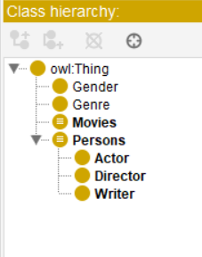
Number of Entities
There are 4 main classes:
Gender
Genre
Movies
Persons
Persons contain 3 subclasses:
Actor
Director
Writer

Slide 4
Number of Relations
Our ontology uses 2 types of relations (properties):
Object Properties
Data Properties

Slide 5
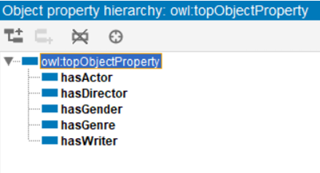
Number of Relations
8 object properties are used:
hasActor
hasDirector
hasGender
hasGenre
hasWriter

Slide 6
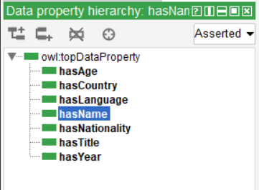
Number of Relations
7 Data properties are used:
hasAge
hasCountry
hasLanguage
hasName
hasNationality
hasTitle
hasYear

Slide 7
Logic
Axioms are used to assert fundamental truths or relationships within the ontology.
SubclassOf: Defines subclass relationships between classes, such as Actor being a subclass of Person.
Domain and Range: Specifies the domain and range of properties, ensuring proper usage. For instance, the domain of hasDirector property is Movie and its range is Director

Slide 8
Logic
Restrictions impose constraints or conditions on classes or properties within the ontology.
Cardinality Restrictions: Specify the number of instances a class may have in relation to a property. For instance, a movie may have one or several directors, writers, or actors, but not zero.
Value Restrictions: Constrain the values that properties may take. For instance, the genre of a movie must be one of Thriller, Crime, Action, Drama, or Comedy.

Slide 9
Logic
Inference rules enable the deduction of additional knowledge or relationships based on existing assertions within the ontology.
Property Inference: Derives new property assertions based on existing property assertions and class memberships. isActorOf is the inverse of has Actor, so it shows what movies each person acted in.

Slide 10
Sample SPARQL queries used in Protege

Slide 11
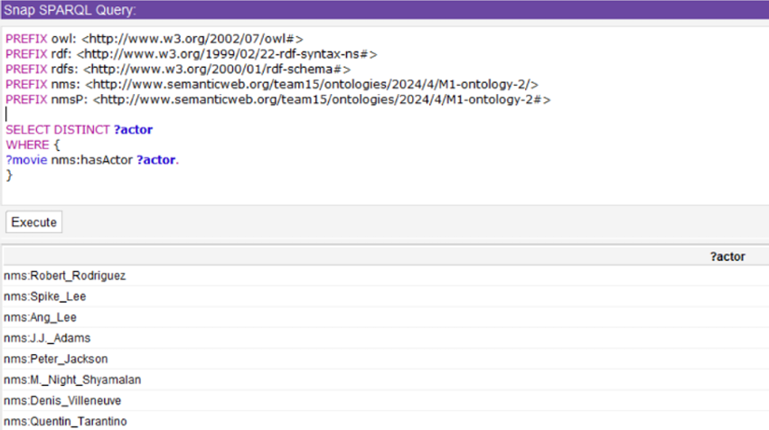
List the instances of the class Actor

Slide 12
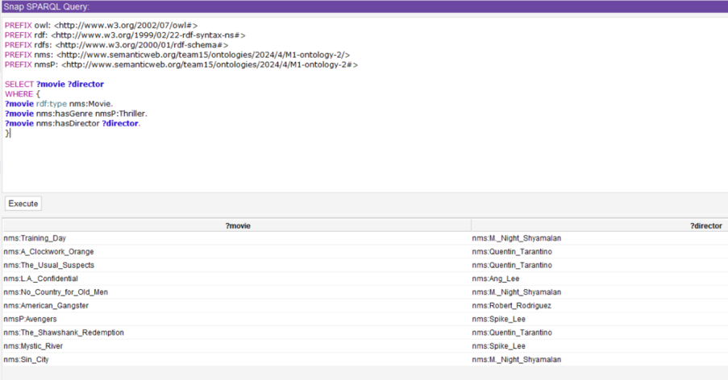
List the name of all Thriller movies. For each one, display its director.

Slide 13
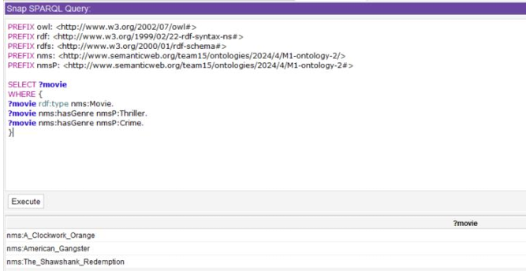
List the name of all Crime Thriller movies.

Slide 14
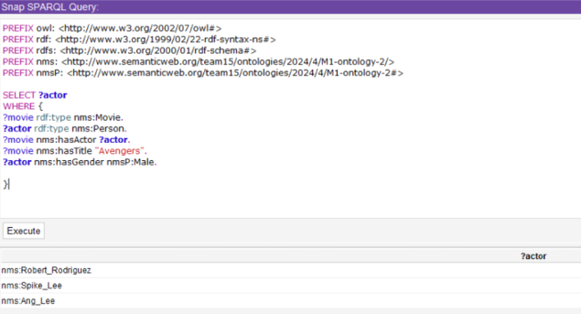
List the male actors in the movie in specific film

Slide 15
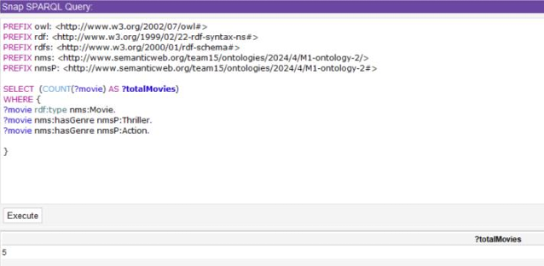
How many movies have both "Action" and "Thriller" as genres?

Slide 16
Extra Sample SPARQL queries used in Protege

Slide 17
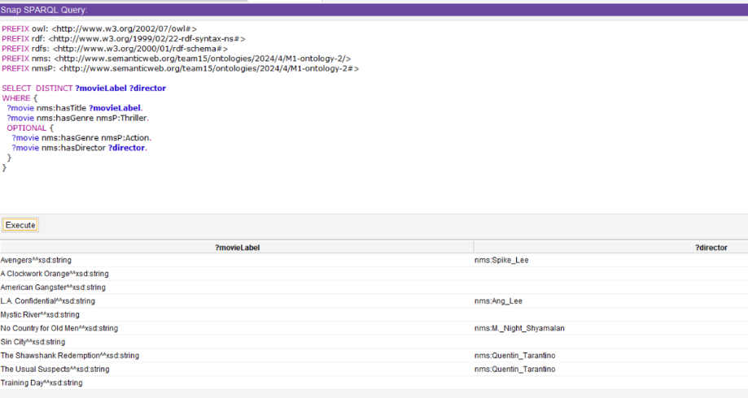
Output all the thriller movies, and if one of those thrillers is Action then also print its director.

Slide 18
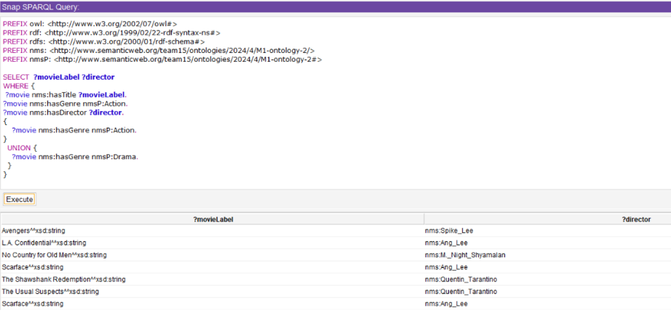
List the movie titles and their respective directors for movies that belong to the genre "Action" or "Drama."

Slide 19
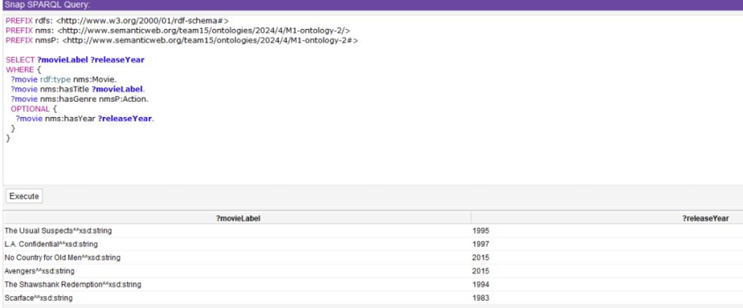
List movie titles that have genre action, and their release year if there is any.

Slide 20
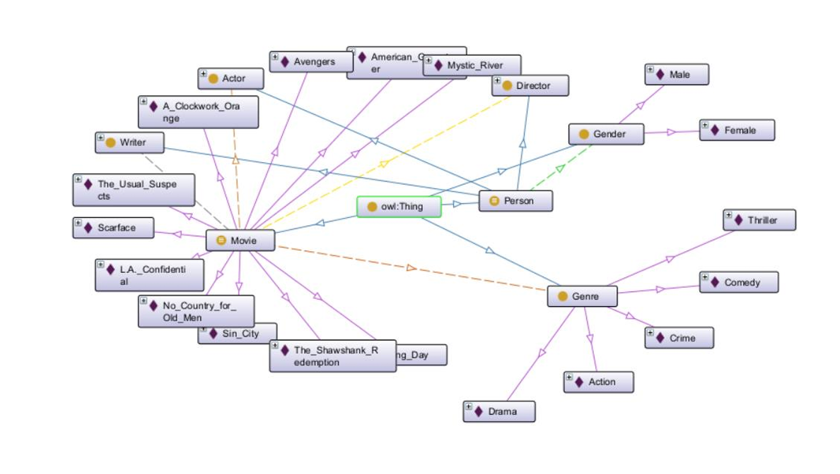
Visualize the Ontology

Slide 21
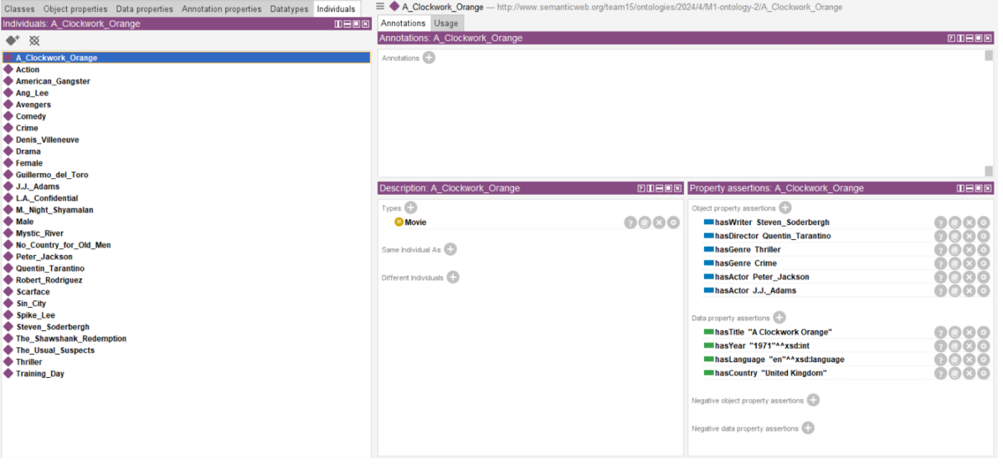
Movie Example:

Slide 22
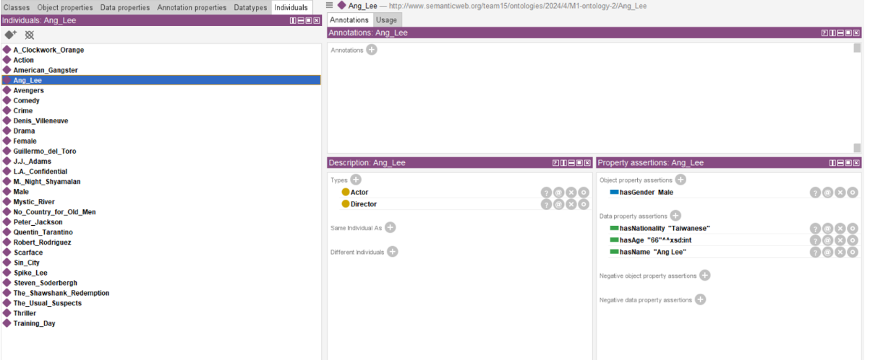
Example of Person

Slide 23
Snapshots of the Programs

Slide 24
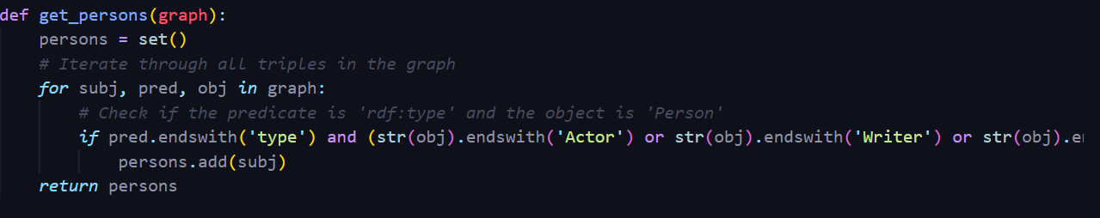
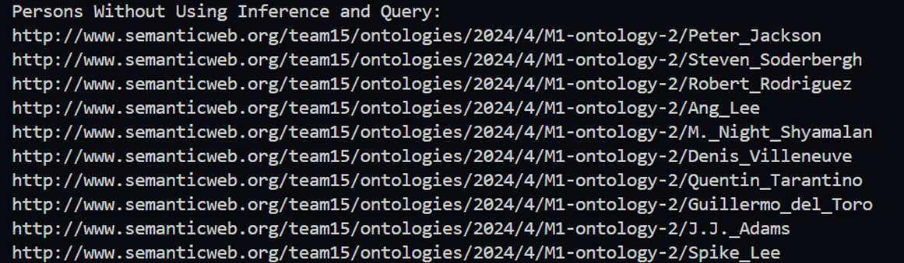
1- Create a program that loads the ontology and displays all the Persons (without using queries, without inference).

Slide 25
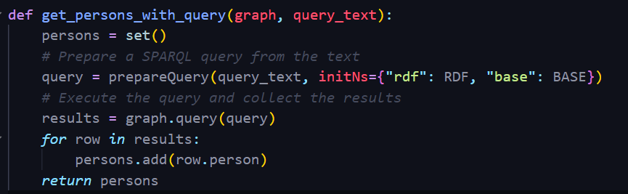
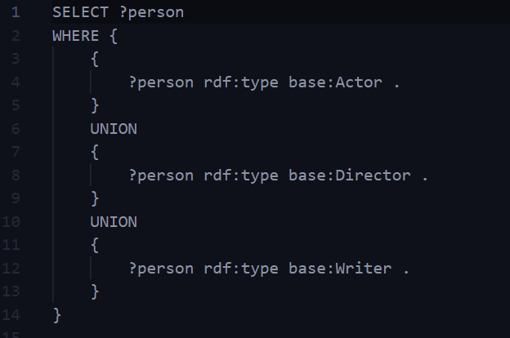
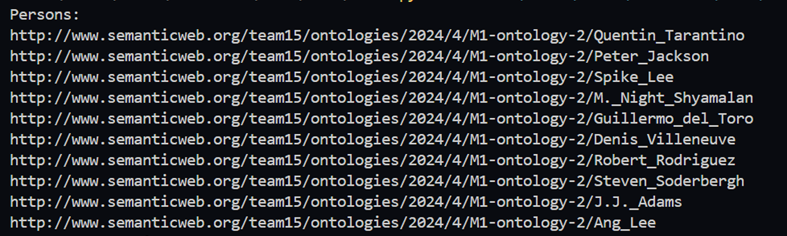
2) Create a program that loads the ontology and displays all the Persons (using a query, without inference). Create the used query in text file under the data folder.

Slide 26
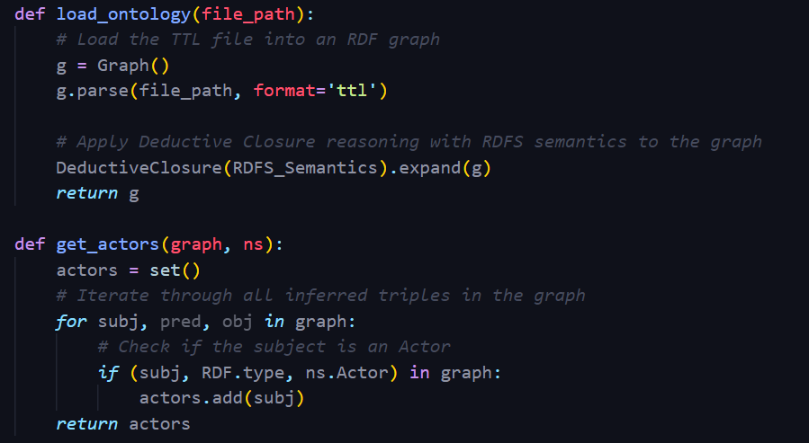
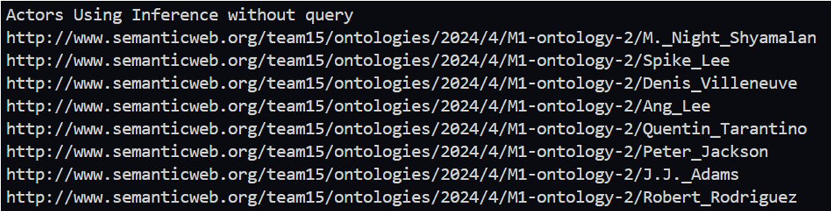
3) Create a program that loads the ontology and displays all the Actors (without using queries, using inference).

Slide 27
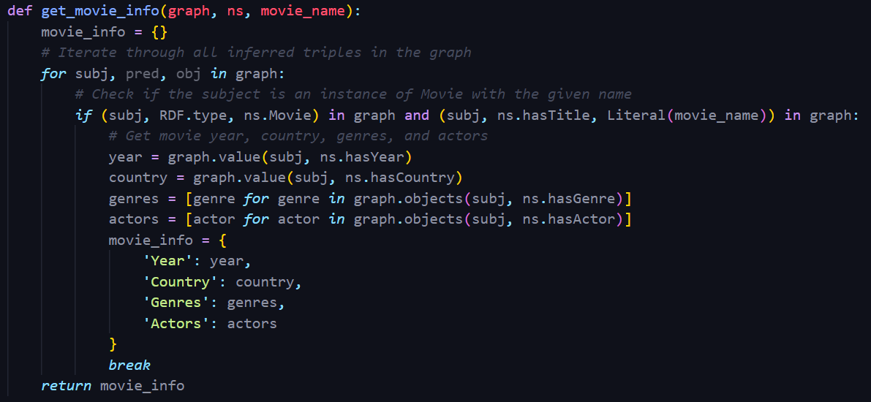
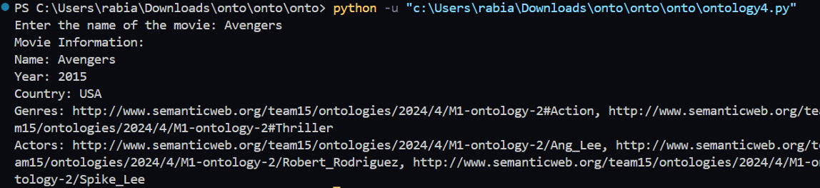
4) Create a program that: Reads a name of a movie, If it doesn’t exist displays an error message, Else, display its year, country, genres and actors

Slide 28
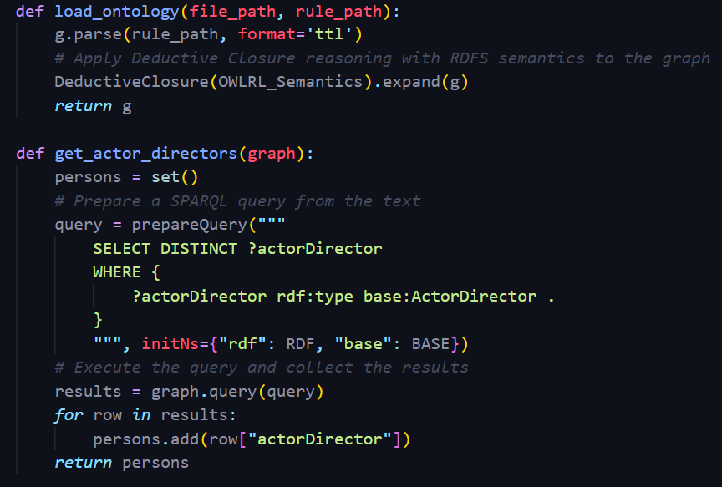
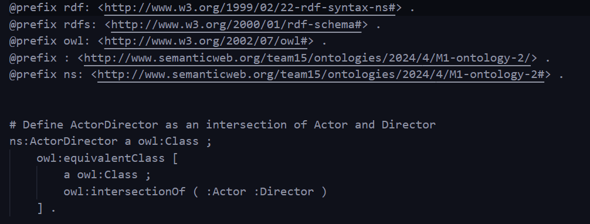
5) Create a java program that displays all persons that are actors and directors. Do this using a rule that defines a new class ActorDirector. The rule file must be saved in the data folder.

Slide 29
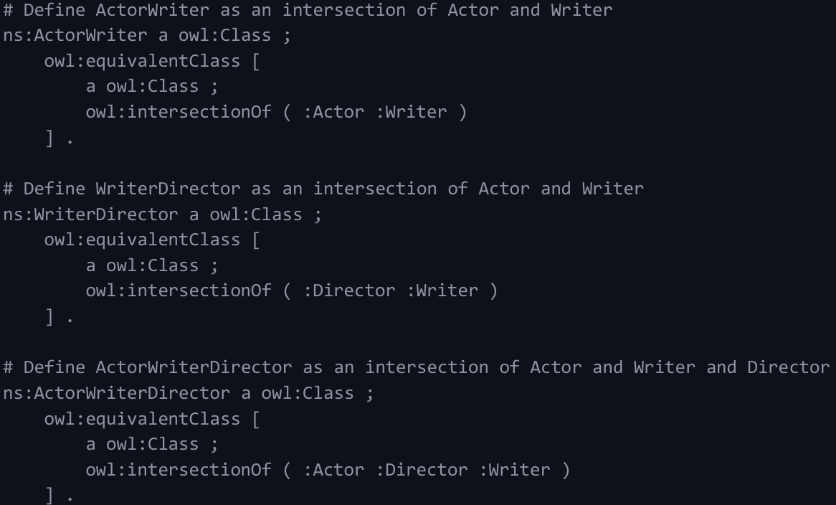
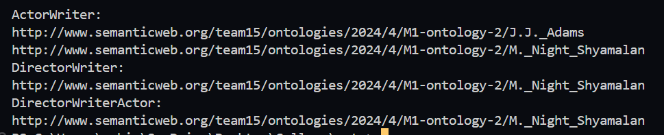
6) Specify 3 different rules and implement them in a java program

Slide 30
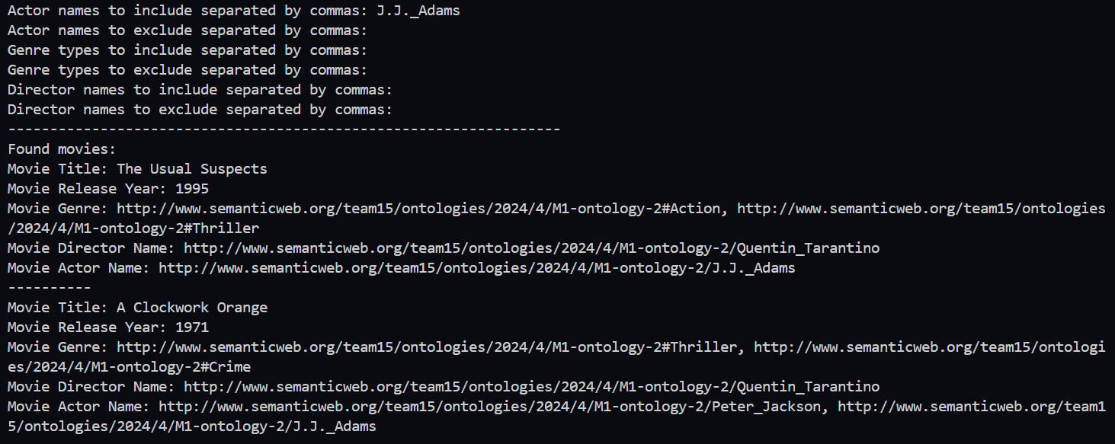
Python APP

Slide 31
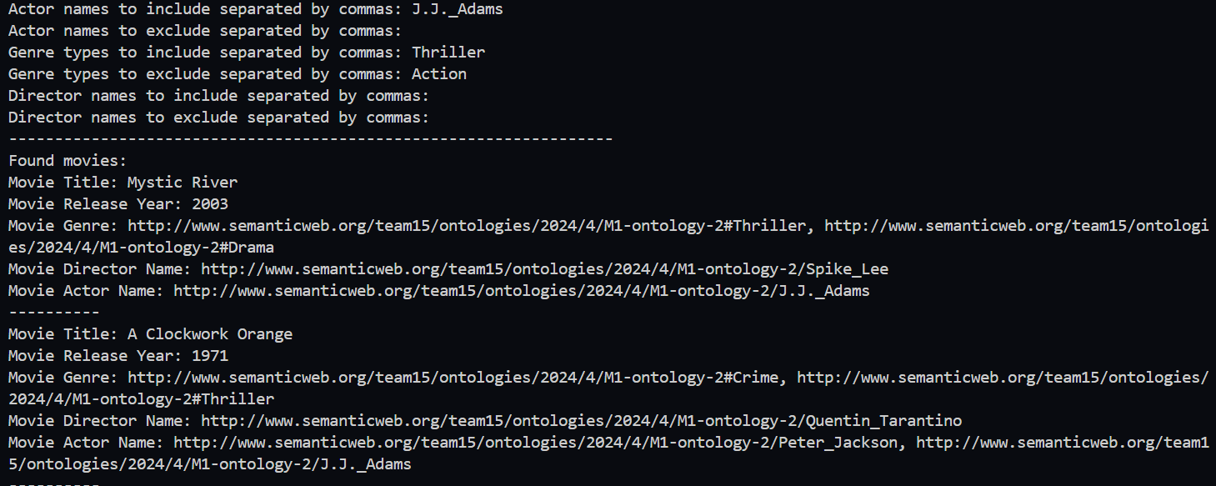

Slide 32
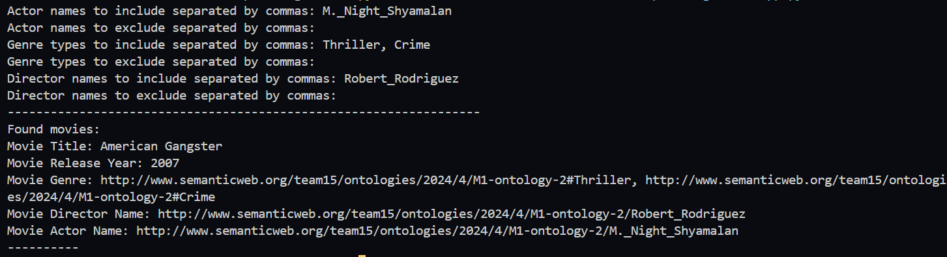

Slide 33
GitHub Link
https://github.com/A7madGX/Ontology_Project

Slide 34
Thank you!

